Slide 1
Collective Phenomena Emerging from the Interactions between Dynamical Processes in Multiplex Networks
Paper by Vincenzo Nicosia, Per Sebastian Skardal, Alex Arenas, Vito Latora
Review by Artem Vergazov
Notes:
I have chosen to review the paper called Collective Phenomena Emerging from the Interactions between Dynamical Processes in Multiplex Networks.

Slide 2
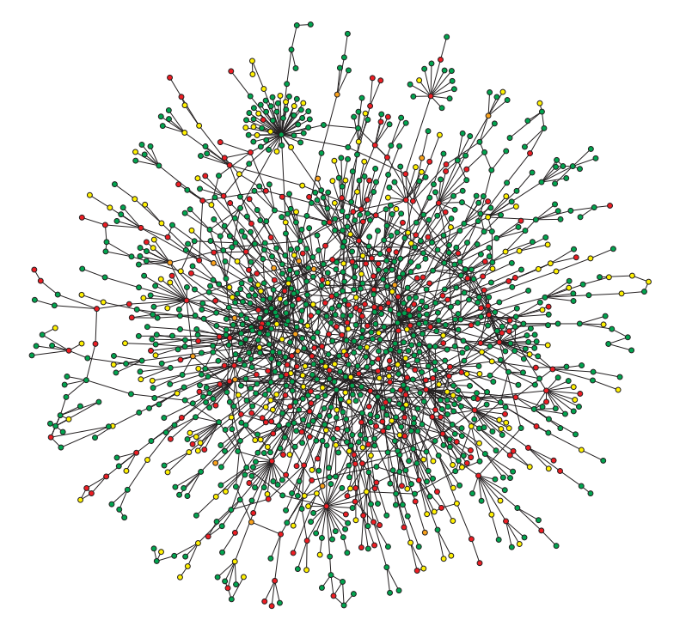
Networks
Notes:
Networks are a powerful tool of modeling phenomena from various fields of science. Network science has found applications in physics, biology, social sciences, etc. The structure of the network (its topology) has effect on the processes that take place over the network. Using networks as a modeling tool opens new possibilities for science in these fields.

Slide 3
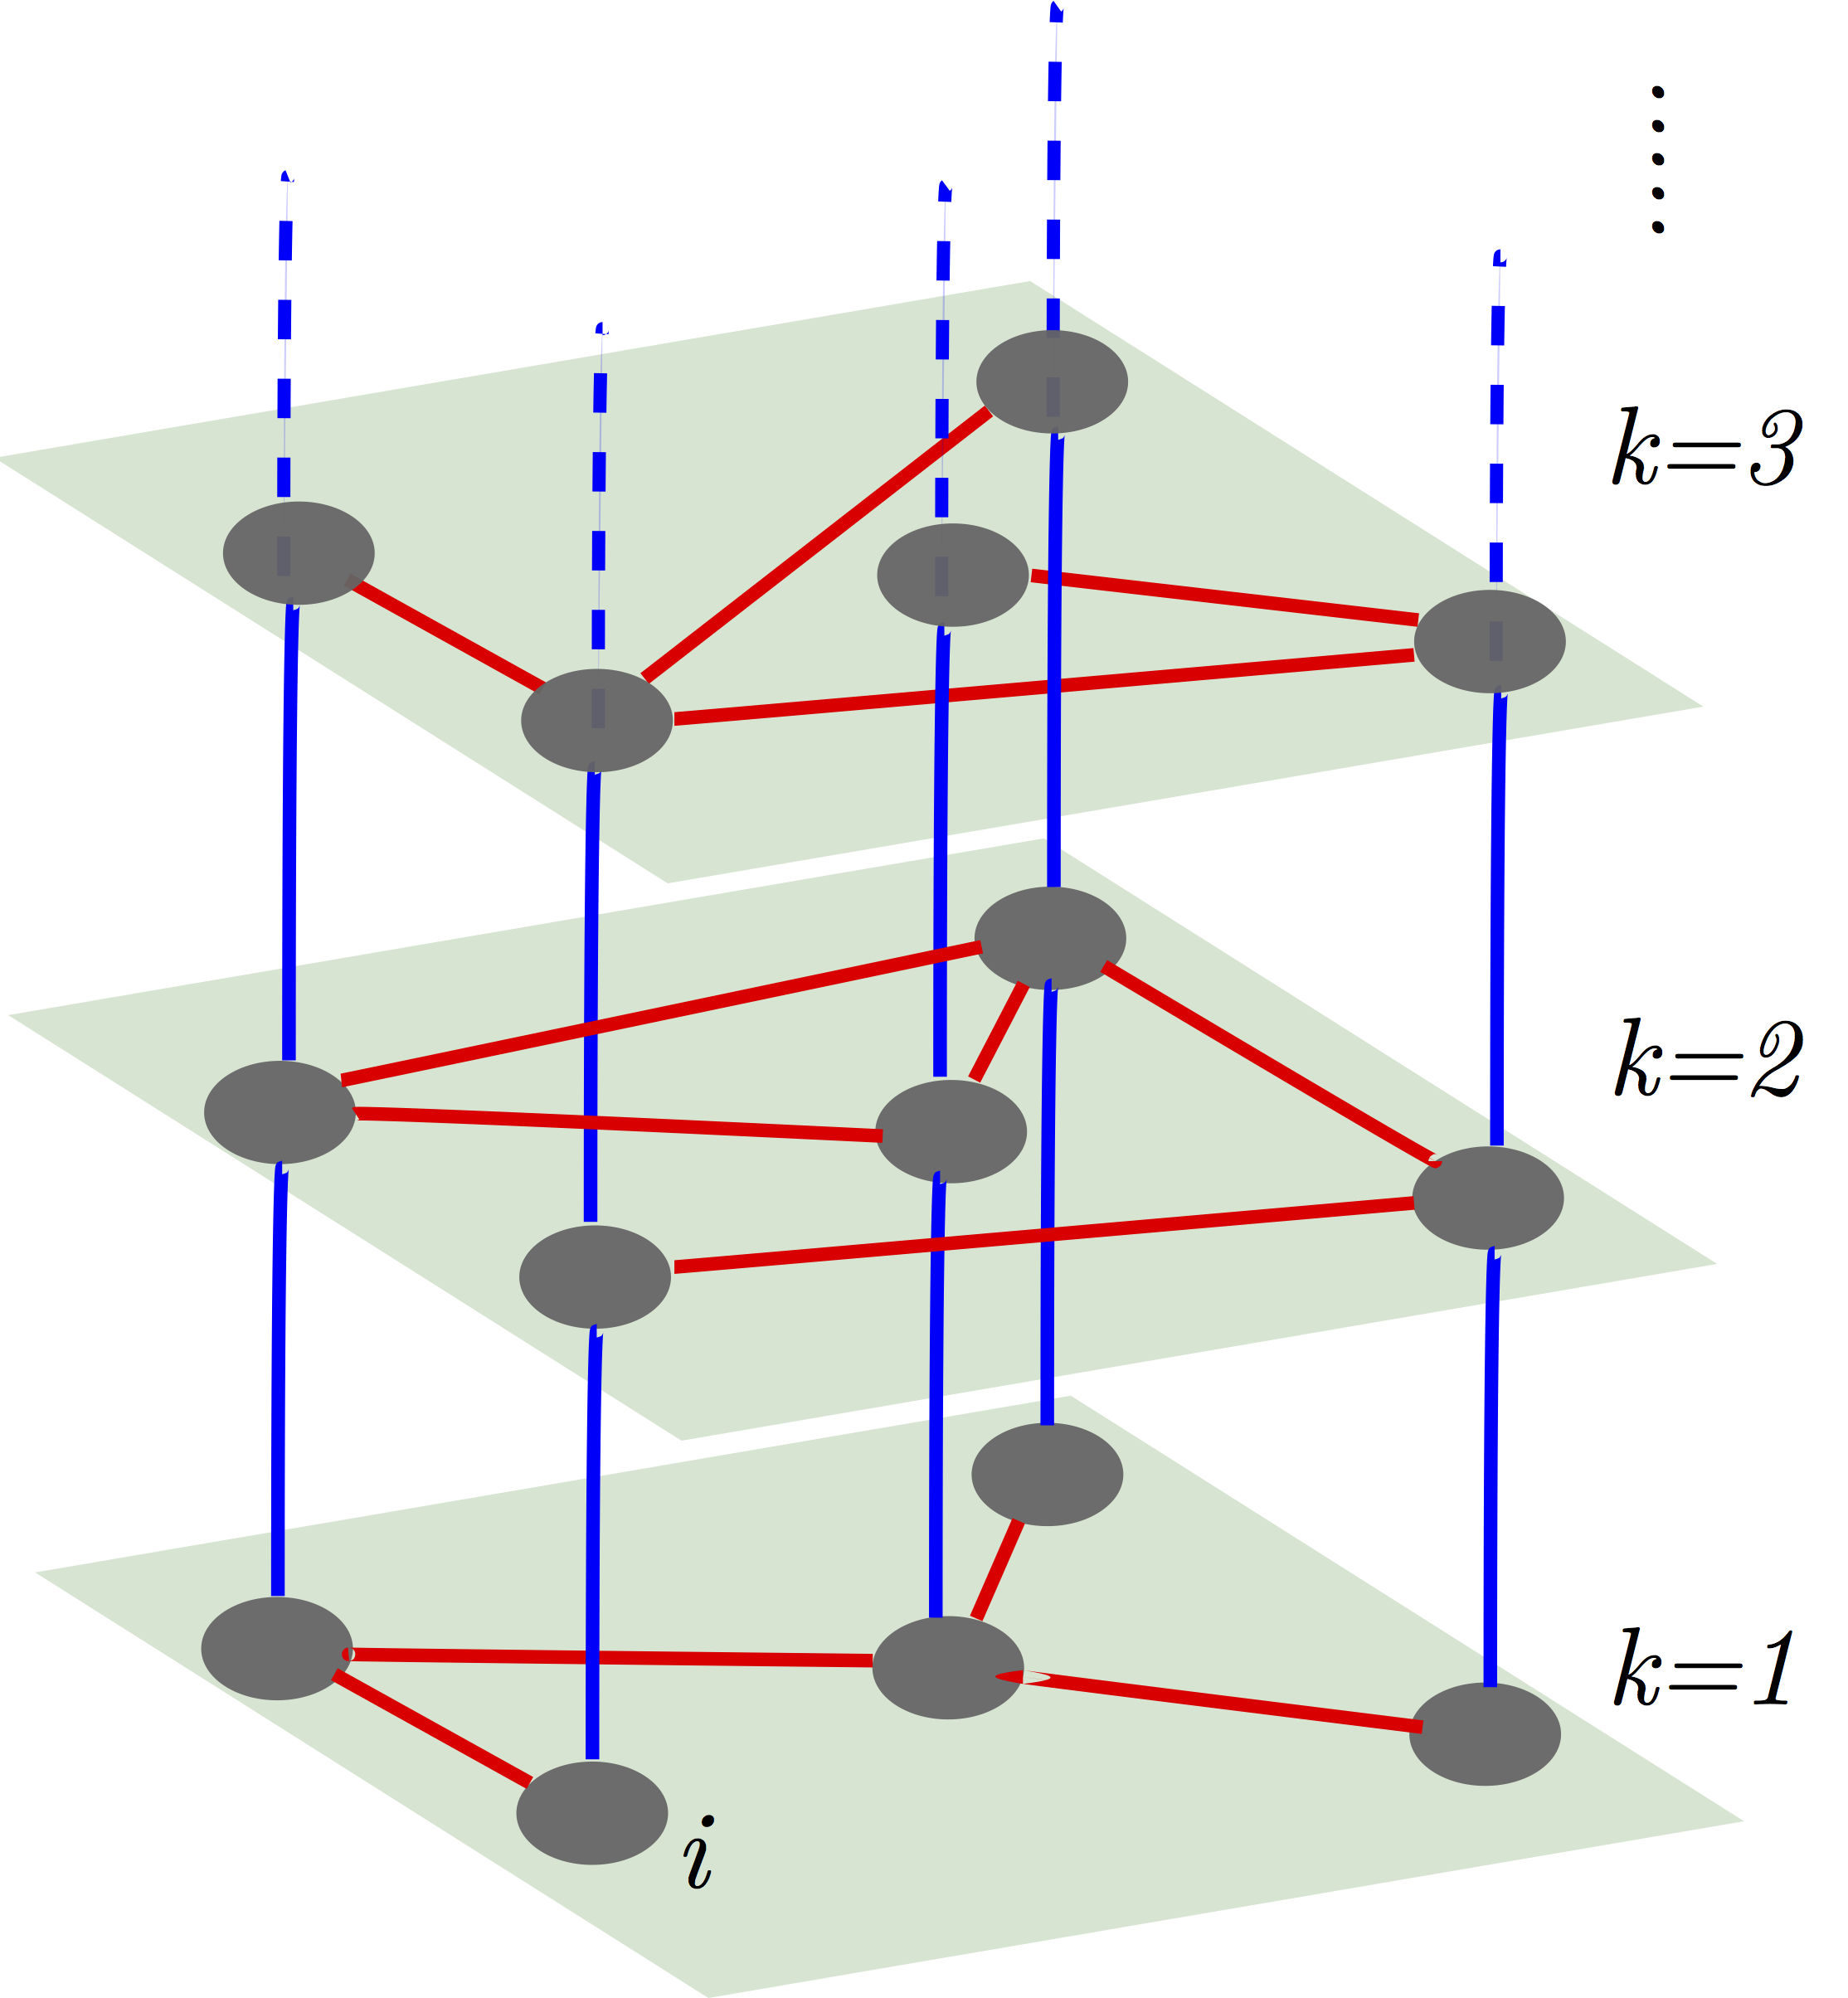
Multiplex networks
Notes:
In some cases, a simple notion of a network is not enough to describe all the complexity of the observed process. Multilayered networks, called multiplex, come to help. A multiplex network is a network of several layers, meanwhile each layer is itself a simple network. Layers must have the same number of nodes, all nodes representing an entity in its different interactions. A typical example of such network would be a 2-layered network with one layer being Facebook network and the other layer being Twitter network. Nodes in these layers represent people participating in these networks, and edges in both layers would represent existence of connection. If two nodes are connected in the first layer, it means they are friends on Facebook. If they are connected in the second layer, it means they follow each other on Twitter. Mulptiplex networks are very powerful tool of modeling complex phenomena where simple networks are not powerful enough.

Slide 4
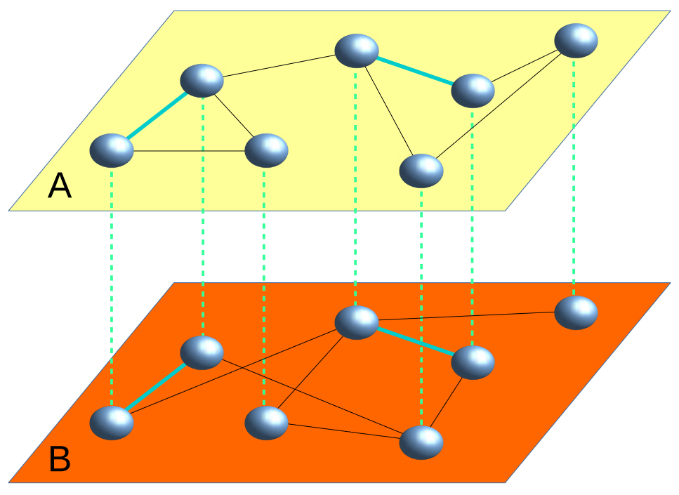
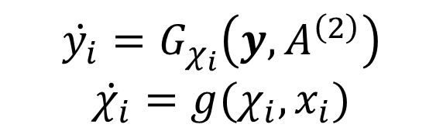
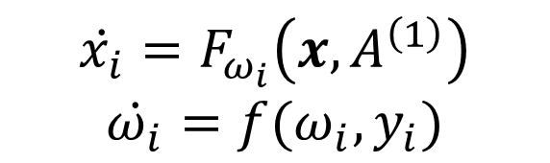
Dynamics on a multiplex network
$$\dot{x_{i}}=F_{ω_{i}}\left(x,A^{\left(1\right)}\right)$$
$$\dot{ω_{i}}=f(ω_{i},y_{i})$$
$$\dot{y_{i}}=G_{χ_{i}}\left(y,A^{\left(2\right)}\right)$$
$$\dot{χ_{i}}=g(χ_{i},x_{i})$$
Notes:
Now, imagine we have something more complex than two social nets. For example, two dynamical processes that interact with each other. One can model such system via multiplex networks framework. In this paper, the authors suggest a general framework for modeling the coupling of dynamical processes. For simplicity, we consider a network with 2 layers which means we have two processes. We assign different dynamical process to each layer. x is the vector of node states for the first process. Y is the vector of node states for the second process. We assume the dynamics of the entire system is governed by these equations. A1 and A2 are adjacency matrices of the two graphs. State x_i is a function of states x and the first network topology. Same for y. The key ingredient that connects the two dynamical processes is provided by the functions omega and chi. In fact, the parameter omega is itself a function of states of the second layer. This allows to encode the interaction between layers in our model and it is only possible because we are working within multiplex networks framework.

Slide 5
Example: model of a human brain
Layer 1: neural activity
$$\dot{x_{i}}=F_{ω_{i}}\left(x,A^{\left(1\right)}\right)$$
$$\dot{ω_{i}}=f(ω_{i},y_{i})$$
Layer 2: energy transport
$$\dot{y_{i}}=G_{χ_{i}}\left(y,A^{\left(2\right)}\right)$$
$$\dot{χ_{i}}=g(χ_{i},x_{i})$$
Notes:
As a specific example of this type of coupling, we consider a toy model of a human brain. The first layer in this case corresponds to neural activity of brain regions. And the second layer corresponds to energy transport across brain regions. Each node in both layers corresponds to a specific brain region.

Slide 6

Example: model of a human brain
Layer 1: neural activity
$x_{i}\left(t\right)∈[0, 2π)$ – phase of oscillator $i$ at time $t$
$$\dot{x_{i}}=F_{ω_{i}}\left(x,A^{\left(1\right)}\right)$$
$$\dot{ω_{i}}=f(ω_{i},y_{i})$$
Kuramoto model:
Layer 2: energy transport
$$\dot{y_{i}}=G_{χ_{i}}\left(y,A^{\left(2\right)}\right)$$
$$\dot{χ_{i}}=g(χ_{i},x_{i})$$
Notes:
To apply the suggested multiplex framework to that system, we have to specify explicitly all the equations on the r. h. s. The equations for neural activity are defined by the Kuramoto model.

Slide 7
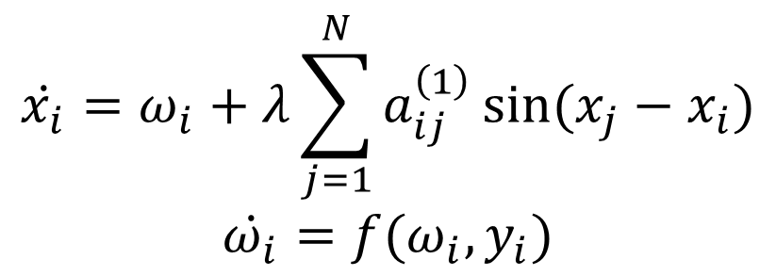

Example: model of a human brain
Layer 1: neural activity
$x_{i}\left(t\right)∈[0, 2π)$ – phase of oscillator $i$ at time $t$
$$\dot{x_{i}}=ω_{i}+λ\sum_{j=1}^{N}{a_{ij}^{\left(1\right)}\sin{(x_{j}−x_{i})}}$$
$$\dot{ω_{i}}=f(ω_{i},y_{i})$$
$λ$ – coupling strength (control parameter)
Kuramoto model:
Layer 2: energy transport
$$\dot{y_{i}}=G_{χ_{i}}\left(y,A^{\left(2\right)}\right)$$
$$\dot{χ_{i}}=g(χ_{i},x_{i})$$
Notes:
Kuramoto model is the model for a set of connected oscillators, so in our case every brain region is modeled as a simple oscillator. Here x is the phase of the oscillator I at time t, omega I is the natural frequency of the oscillator and here arises lambda – coupling strength. This is our first control parameter that has to be specified outside of the model manually. In total, we will have 2 of them.

Slide 8
Example: model of a human brain
Layer 1: neural activity
$x_{i}\left(t\right)∈[0, 2π)$ – phase of oscillator $i$ at time $t$
$$\dot{x_{i}}=ω_{i}+λ\sum_{j=1}^{N}{a_{ij}^{\left(1\right)}\sin{(x_{j}−x_{i})}}$$
$$\dot{ω_{i}}=f(ω_{i},y_{i})$$
$λ$ – coupling strength (control parameter)
Kuramoto model:
Layer 2: energy transport
$$\dot{y_{i}}=G_{χ_{i}}\left(y,A^{\left(2\right)}\right)$$
$$\dot{χ_{i}}=g(χ_{i},x_{i})$$
Continuous-time RW:
Notes:
The second dynamical process, energy transport, is modeled by the cont.-time RW.

Slide 9
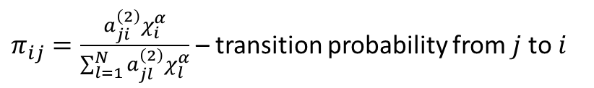
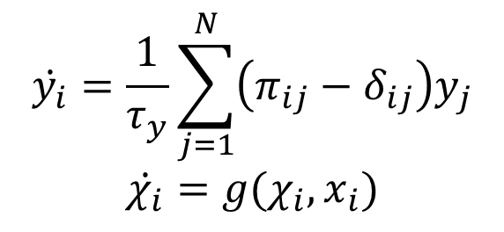
Example: model of a human brain
Layer 1: neural activity
$x_{i}\left(t\right)∈[0, 2π)$ – phase of oscillator $i$ at time $t$
$$\dot{x_{i}}=ω_{i}+λ\sum_{j=1}^{N}{a_{ij}^{\left(1\right)}\sin{(x_{j}−x_{i})}}$$
$$\dot{ω_{i}}=f(ω_{i},y_{i})$$
$λ$ – coupling strength (control parameter)
Kuramoto model:
Layer 2: energy transport
$y_{i}\left(t\right)∈[0, 1]$ – fraction of RWs at node $i$ at time $t$
$$\dot{y_{i}}=\frac{1}{τ_{y}}\sum_{j=1}^{N}{\left(π_{ij}−δ_{ij}\right)y_{j}}$$
$$\dot{χ_{i}}=g(χ_{i},x_{i})$$
$π_{ij}=\frac{a_{ji}^{\left(2\right)}χ_{i}^{α}}{\sum_{l=1}^{N}{a_{jl}^{\left(2\right)}χ_{l}^{α}}}$ – transition probability from $j$ to $i$
Continuous-time RW:
$χ_{i}$ – node bias for RW
$α$ – bias exponent (control parameter)
Notes:
The state Y_i is the fraction of RWs. And pi_ij is the transition probability from j to i. tau_y is the time scale of the process. We also assume that our RW is biased with the parameter chi_i and here arises our second control parameter alpha which is the bias exponent. It controls the bias of RW. To completely define the model, we have to specify how these two processes, the neural dynamics and the diffusion of nutrients, are coupled. We need to assign the functions f and g. f will relate the frequency of the oscillator w to the available energy resource y. G will relate the bias property chi to the oscillator phase x.

Slide 10
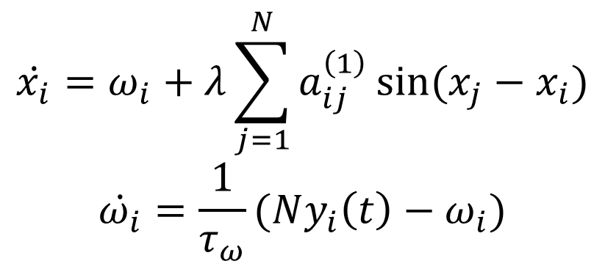
Coupling the neural dynamics and the diffusion of nutrients
Layer 1: neural activity
$x_{i}\left(t\right)∈[0, 2π)$ – phase of oscillator $i$ at time $t$
$$\dot{x_{i}}=ω_{i}+λ\sum_{j=1}^{N}{a_{ij}^{\left(1\right)}\sin{(x_{j}−x_{i})}}$$
$$\dot{ω_{i}}=\frac{1}{τ_{ω}}(Ny_{i}\left(t\right)−ω_{i})$$
$λ$ – coupling strength (control parameter)
Kuramoto model:
higher frequency requires more energy
Layer 2: energy transport
$y_{i}\left(t\right)∈[0, 1]$ – fraction of RWs at node $i$ at time $t$
$$\dot{y_{i}}=\frac{1}{τ_{y}}\sum_{j=1}^{N}{\left(π_{ij}−δ_{ij}\right)y_{j}}$$
$$\dot{χ_{i}}=g(χ_{i},x_{i})$$
$π_{ij}=\frac{a_{ji}^{\left(2\right)}χ_{i}^{α}}{\sum_{l=1}^{N}{a_{jl}^{\left(2\right)}χ_{l}^{α}}}$ – transition probability from $j$ to $i$
Continuous-time RW:
$χ_{i}$ – node bias for RW
$α$ – bias exponent (control parameter)
Notes:
Assuming that frequencies relax to the values proportional to the fraction of RWs at node I, we get the following equation. The physical intuition behind that is that firing at a higher frequency usually requires a correspondingly higher amount of energy, in the form of oxygen and nutrients.

Slide 11

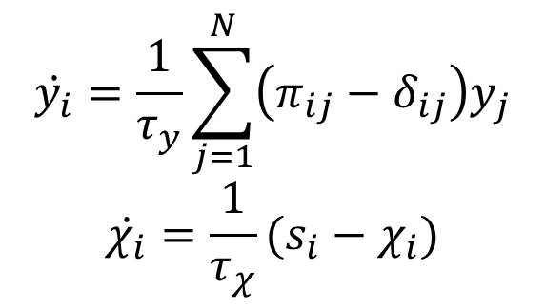
Coupling the neural dynamics and the diffusion of nutrients
Layer 1: neural activity
$x_{i}\left(t\right)∈[0, 2π)$ – phase of oscillator $i$ at time $t$
$$\dot{x_{i}}=ω_{i}+λ\sum_{j=1}^{N}{a_{ij}^{\left(1\right)}\sin{(x_{j}−x_{i})}}$$
$$\dot{ω_{i}}=\frac{1}{τ_{ω}}(Ny_{i}\left(t\right)−ω_{i})$$
$λ$ – coupling strength (control parameter)
Kuramoto model:
higher frequency requires more energy
Layer 2: energy transport
$y_{i}\left(t\right)∈[0, 1]$ – fraction of RWs at node $i$ at time $t$
$$\dot{y_{i}}=\frac{1}{τ_{y}}\sum_{j=1}^{N}{\left(π_{ij}−δ_{ij}\right)y_{j}}$$
$$\dot{χ_{i}}=\frac{1}{τ_{χ}}(s_{i}−χ_{i})$$
$π_{ij}=\frac{a_{ji}^{\left(2\right)}χ_{i}^{α}}{\sum_{l=1}^{N}{a_{jl}^{\left(2\right)}χ_{l}^{α}}}$ – transition probability from $j$ to $i$
Continuous-time RW:
$χ_{i}$ – node bias for RW
$α$ – bias exponent (control parameter)
higher electrical activity requires blood inflow
$s_{i}$ – dynamic strength of node $i$
Notes:
Next, in the similar fashion, we relate chi and x. This function s is dependent on x and is the dynamic strength of node i. The physical intuition behind that is that high electrical activity of a brain area is normally followed by an increase in the blood inflow in the same area.

Slide 12
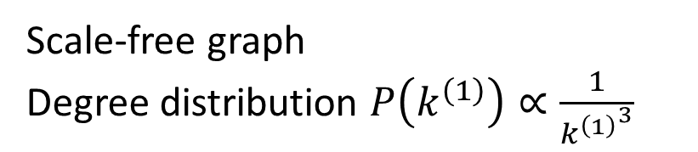
Modeling
Scale-free graph
Degree distribution $P\left(k^{\left(1\right)}\right)∝\frac{1}{{k^{\left(1\right)}}^{3}}$
Erdős–Rényi graph
Poisson degree distribution
Notes:
After we specified all the equations of the framework, to run the simluations, we consider a multiplex network of 1000 nodes. We will model the layer corresponding to neural activity as a scale free network with powerlaw degree distribution given the prevalence of such topologies in real neural systems. We will model the transport layer as a simple ER graph.

Slide 13
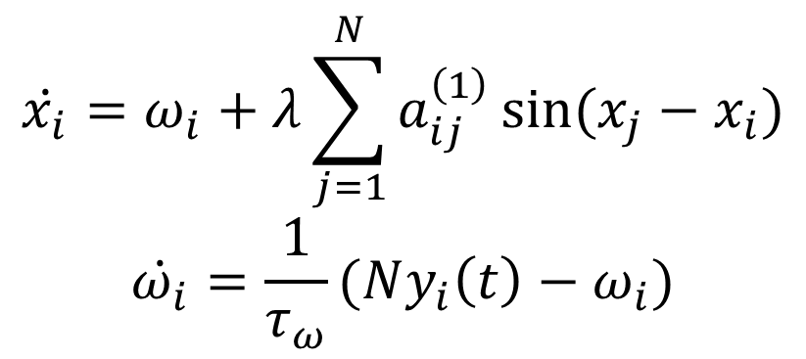

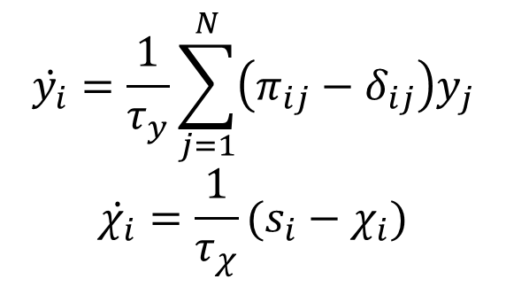
Fast relaxation approximation
$$\dot{x_{i}}=ω_{i}+λ\sum_{j=1}^{N}{a_{ij}^{\left(1\right)}\sin{(x_{j}−x_{i})}}$$
$$\dot{ω_{i}}=\frac{1}{τ_{ω}}(Ny_{i}\left(t\right)−ω_{i})$$
$$τ_{y}→0$$
$$τ_{ω}→0$$
$$τ_{χ}→0$$
$$\dot{y_{i}}=\frac{1}{τ_{y}}\sum_{j=1}^{N}{\left(π_{ij}−δ_{ij}\right)y_{j}}$$
$$\dot{χ_{i}}=\frac{1}{τ_{χ}}(s_{i}−χ_{i})$$
Notes:
The authors also simplified the model by considering the fast relaxation approximation. In all aquations they considered the limit as the relaxation times approach zero. I don’t know how they did it exactly because the derivations were in the Supplementary material that had to be paid for. I didn’t want to pay. I just tried to do the same thing in my own way. If we model the dynamics using first order Euler numerical scheme, this is what our equations will rewrite as:

Slide 14
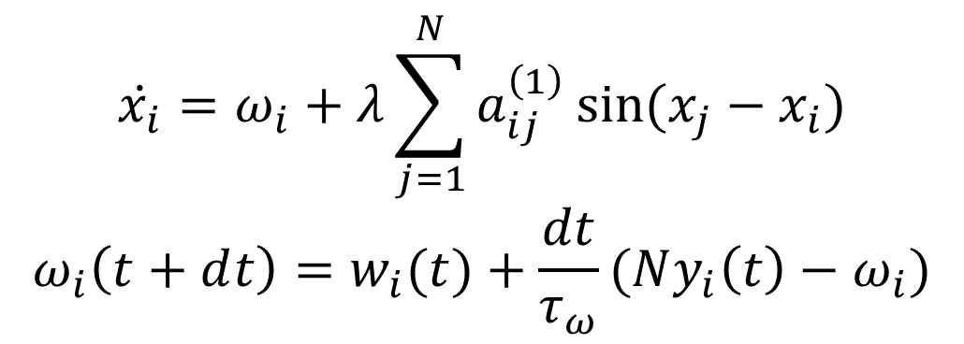
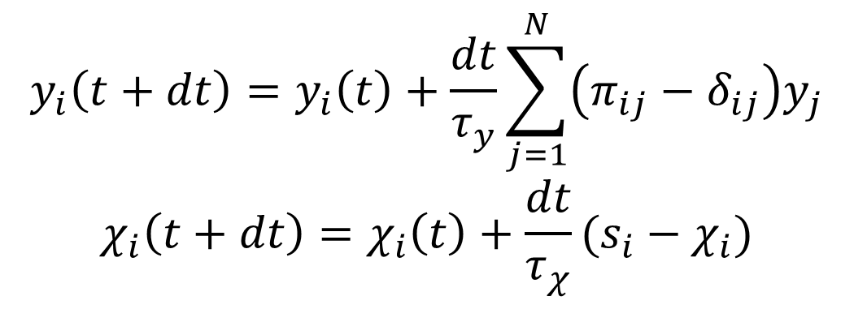
Fast relaxation approximation
$$\dot{x_{i}}=ω_{i}+λ\sum_{j=1}^{N}{a_{ij}^{\left(1\right)}\sin{(x_{j}−x_{i})}}$$
$$ω_{i}\left(t+ⅆt\right)=w_{i}(t)+\frac{dt}{τ_{ω}}(Ny_{i}\left(t\right)−ω_{i})$$
$$τ_{y}→0$$
$$τ_{ω}→0$$
$$τ_{χ}→0$$
$$y_{i}\left(t+dt\right)=y_{i}\left(t\right)+\frac{dt}{τ_{y}}\sum_{j=1}^{N}{\left(π_{ij}−δ_{ij}\right)y_{j}}$$
$$χ_{i}\left(t+dt\right)=χ_{i}\left(t\right)+\frac{dt}{τ_{χ}}(s_{i}−χ_{i})$$
Notes:
And if we assume tau to approach zero and dt approach zero with the same speed, it means they cancel out.

Slide 15
Fast relaxation approximation
$$\dot{x_{i}}=ω_{i}+λ\sum_{j=1}^{N}{a_{ij}^{\left(1\right)}\sin{(x_{j}−x_{i})}}$$
$$ω_{i}\left(t+ⅆt\right)=w_{i}(t)+\frac{dt}{τ_{ω}}(Ny_{i}\left(t\right)−ω_{i})$$
$$τ_{y}→0$$
$$τ_{ω}→0$$
$$τ_{χ}→0$$
$$y_{i}\left(t+dt\right)=y_{i}\left(t\right)+\frac{dt}{τ_{y}}\sum_{j=1}^{N}{\left(π_{ij}−δ_{ij}\right)y_{j}}$$
$$χ_{i}\left(t+dt\right)=χ_{i}\left(t\right)+\frac{dt}{τ_{χ}}(s_{i}−χ_{i})$$

Slide 16
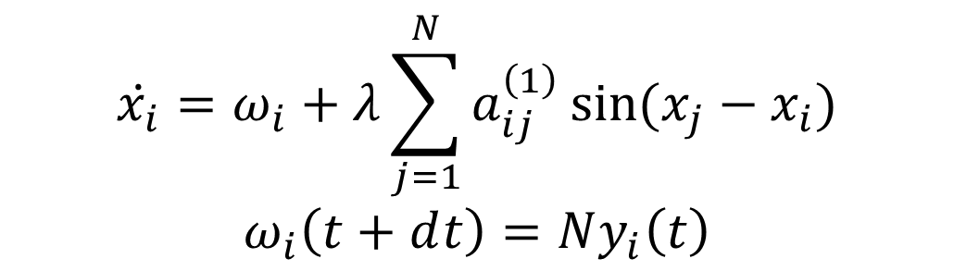
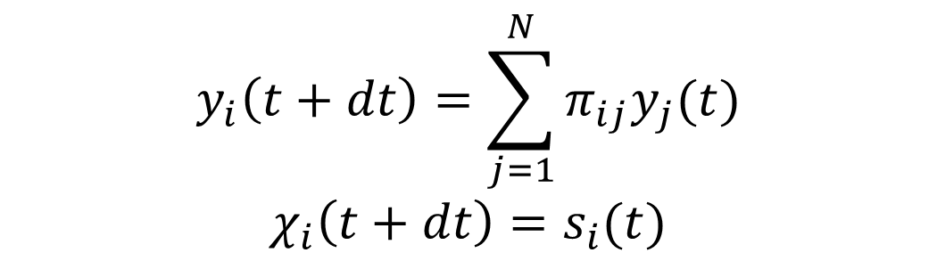
Fast relaxation approximation
$$\dot{x_{i}}=ω_{i}+λ\sum_{j=1}^{N}{a_{ij}^{\left(1\right)}\sin{(x_{j}−x_{i})}}$$
$$ω_{i}\left(t+ⅆt\right)=Ny_{i}\left(t\right)$$
$$τ_{y}→0$$
$$τ_{ω}→0$$
$$τ_{χ}→0$$
$$y_{i}\left(t+dt\right)=\sum_{j=1}^{N}{π_{ij}y_{j}(t)}$$
$$χ_{i}\left(t+dt\right)=s_{i}(t)$$
Notes:
After some algebra, this is what our equations now look like and its very simple to model.

Slide 17
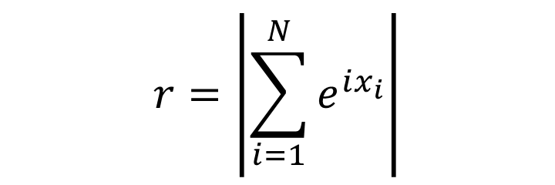
Metric
$$r=\left|\sum_{i=1}^{N}{e^{ix_{i}}}\right|$$
Kuramoto order parameter – degree of the global synchronization
Notes:
This is the metric that we will measure during the simulations. It is the absolute value of the following complex numer which is the centroid of all the oscillators on the complex plane. It is called Kuramoto order parameter and is the degree of the global synchronization of the neural activity.

Slide 18
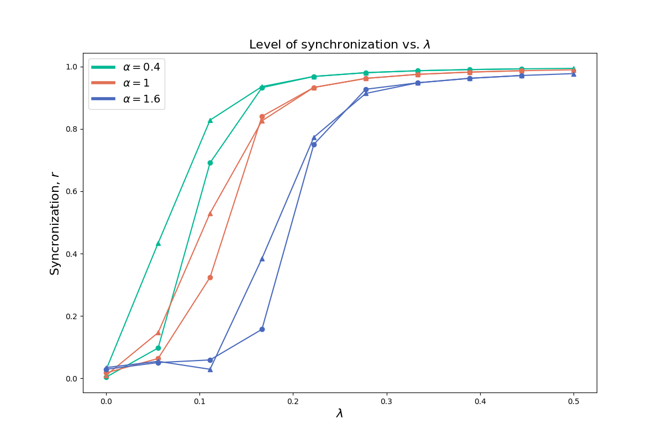
Simulation
Notes:
We have two control paramteres in our model – alpha and lambda. We simulate the networks by adiabatically increasing and the decreasing the coupling strength lambda at fixed values of bias parameter alpha. In the figure, one sees the plot of the synchronization degree vs. lambda. Important to note that we see a hysteresis loop emerging here. In the forward (circle markers) and backward (triangle markers) branches. These results indicate that the interconnected nature of diffusion process and synchronization dynamics gives rise to the emergence of phenomena which would never occur in any other simple model rather than multiplex networks framework which once again proves the usefulness of multiplex networks approach.

Slide 19
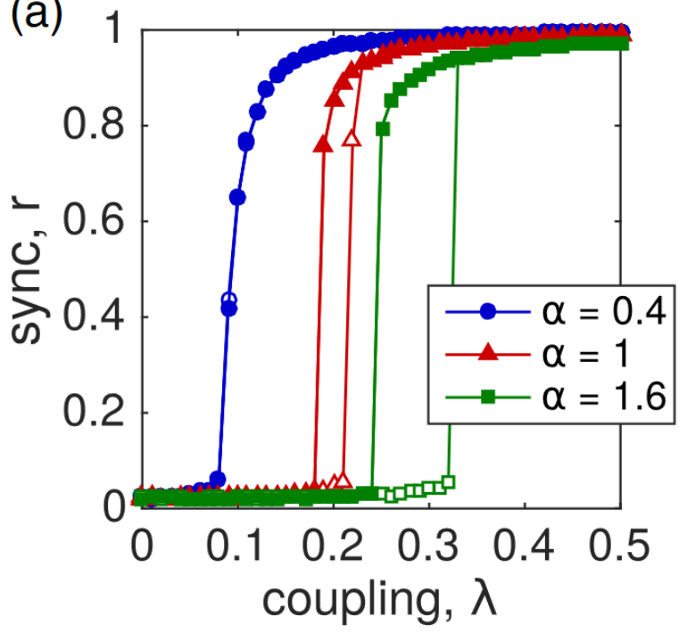
Simulation
Notes:
Comparison with the results of the same experiment conducted by the authors of the paper.

Slide 20
References
Vincenzo Nicosia, Per Sebastian Skardal, Alex Arenas, and Vito Latora. Phys. Rev. Lett. 118, 138302 (2017)

